Slide 1
CAMARA EdgeCloud Use Case MVP Proposal

Slide 2
INSERT SUBHEADING
Index
Edge Cloud APIs collision analysis with all intents
Minimum set of intents for a MVP proposal
MVP API Methods mapping with Intents
User Storys
Intents Flow Graph

Slide 3
Intents and mapping to APIs (with all intents)
CAMARA EDGE CLOUD STATUS

Slide 4
Minimum set of intents for an MVP proposal
CAMARA EDGE CLOUD STATUS
For an MVP the following proposal includes lifecycle management and discovery of application:
Application provider intents: Provisioning intents
1. “I can retrieve a list of the operator’s MECs and their status, ordering the results by location and filtering by status (active/inactive/unknown)” 5. "I can ask the operator to provision my application server to the optimal MEC for a specific terminal, to one or several EAS taking into account connectivity, resources (e.g. vCPU, Memory, network interfaces, storage, GPU) shortest network path, cost, network load, MEC platform load, application privacy considerations etc."
7. “I can ask the operator to store artifacts e.g., container images or VM images and manifests describing required resources, Helm charts etc”
User Equipment intents: Runtime intents
21. "I can discover the optimal application service endpoint for a specific terminal, taking into account mobility events, connectivity, shortest network path, cost, network load, MEC platform load etc."
Application provider intents: Termination intents
18. "I can ask the operator to terminate the running instance of my application"
11. "I can ask the operator to delete an existing artifact(s)"

Slide 5
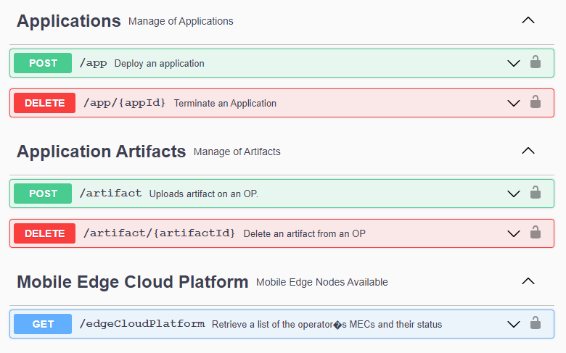
Minimum set of intents for an MVP proposal
CAMARA EDGE CLOUD STATUS
For an MVP the following proposal includes lifecycle management and discovery of application:
Intent 5
Intent 18
Intent 7
Intent 11
Intent 1

Slide 6
User Story: Provisioning and runtime
camara Edge cloud status
Item | Description
Summary | Network operators offers a Multi-access Edge Computing (MEC, or ‘Edge’) platform in a given territory that contain ‘Edge Application Servers’ (EAS). Network operators offers a service through EdgeCloud APIs that permits application providers to deploy instances of an application in one or several MECs/EAS, and to Applications Users the posibility to chose the most appropriate MEC available at a given moment
Roles, Actor(s) and scope | Application Provider (AP): role of EdgeCloud API consumer for App Lifecicle Management. Operator Platform (OP): role of EdgeCloud API provider User Equipment (UE): role of EdgeCloud API consumer for discovery and Service consumer Edge Application Server (EAS): role of Service producer Scope: B2B use case to instantiate apps by Aplication Providers and lifecycle management. B2C use case for User Equipment discovery and service
Pre-conditions | The AP has a resource usage agreement with the Operator Platform
Begins when | The Application Provider (AP) invokes the EdgeCloud API to upload the artifact e.g. container images or VM images and manifests describing required resources by an application
Step 1 | The OP authorizes the request (terminates with a notification to the AP if it is not valid)
Step 2 | The OP validates the request (terminates with a notification to the AP if content is not valid)
Step 3 | The OP stores the artifact and returns an Id for reference (terminates with a notification to the AP if error)
Step 4 | The AP invokes the EdgeCloud API to retrieve a list of the operator’s MECs and their status
Step 5 | The AP invokes the EdgeCloud API to provision the application referencing previously uploaded artifact in all EAS that meet certain criteria
Step 6 | The OP deploy an instance of the application in all EAS that meet the criteria, if no criteria given it deploys the app instance in all available EAS if succesfull returns an AppIdentifier ( If it could not find at least one EAS available terminates with an error notification to the AP)
Step 7 | The UE invokes the EdgeCloud API (the AppId) to discover the optimal EAS for my application and a particular terminal
Step 8 | The OP authorizes the request (terminates with a notification to the UE if it is not valid)
Step 9 | The OP validates the request (terminates with a notification to the UE if content is not valid e.g. given appId does not exist)
Step 10 | The OP checks with of the EAS with a running instance of that AppId is optimal for that user and returns the connection URL in the response (terminates with a notification to the UE if no EAS available for that appId)
Step 11 | The UE connects to the provided EAS and start using the application
Ends when | The UE connects to the EAS or an error occurs in a previous step

Slide 7
User Story: Termination
camara Edge cloud status
Item | Description
Summary | Network operators offers a Multi-access Edge Computing (MEC, or ‘Edge’) platform in a given territory that contain ‘Edge Application Servers’ (EAS). Network operators offers a service through EdgeCloud APIs that permits application providers to remove previously deployed application instances
Roles, Actor(s) and scope | Application Provider (AP): role of EdgeCloud API consumer for App Lifecicle Management. Operator Platform (OP): role of EdgeCloud API provider User Equipment (UE): role of EdgeCloud API consumer for discovery and Service consumer Edge Application Server (EAS): role of Service producer Scope: B2B use case to terminate and remove apps by Aplication Providers.
Pre-conditions | The AP has previously deployed at least an instance of an applicaciont in one EAS
Begins when | The Application Provider (AP) invokes the EdgeCloud API to remove the application ( given an appId) in all EAS that meet the criteria ,if no criteria given it removes the app instance in all available EAS
Step 1 | The OP authorizes the request (terminates with a notification to the AP if it is not valid)
Step 2 | The OP validates the request (terminates with a notification to the AP if appId is not valid)
Step 3 | The OP remove app instance in all EAS that meet the Criteria ( all of them if no criteria given) and returns an operation result
Step 4 | The Application Provider (AP) invokes the EdgeCloud API to remove the artifact previously uploaded with an artifactID
Step 5 | The OP authorizes the request (terminates with a notification to the AP if it is not valid)
Step 6 | The OP validates the request (terminates with a notification to the AP if artifactID is not valid or if an instance is deployed referencing that artifactID)
Step 7 | The OP authorizes remove artifact from the platform and returns an operation result (terminates with a notification to the AP if it is not valid)
Ends when | The Deletion of app instances ( if any) and artifacts is completed by OP with response to the AP

Slide 8
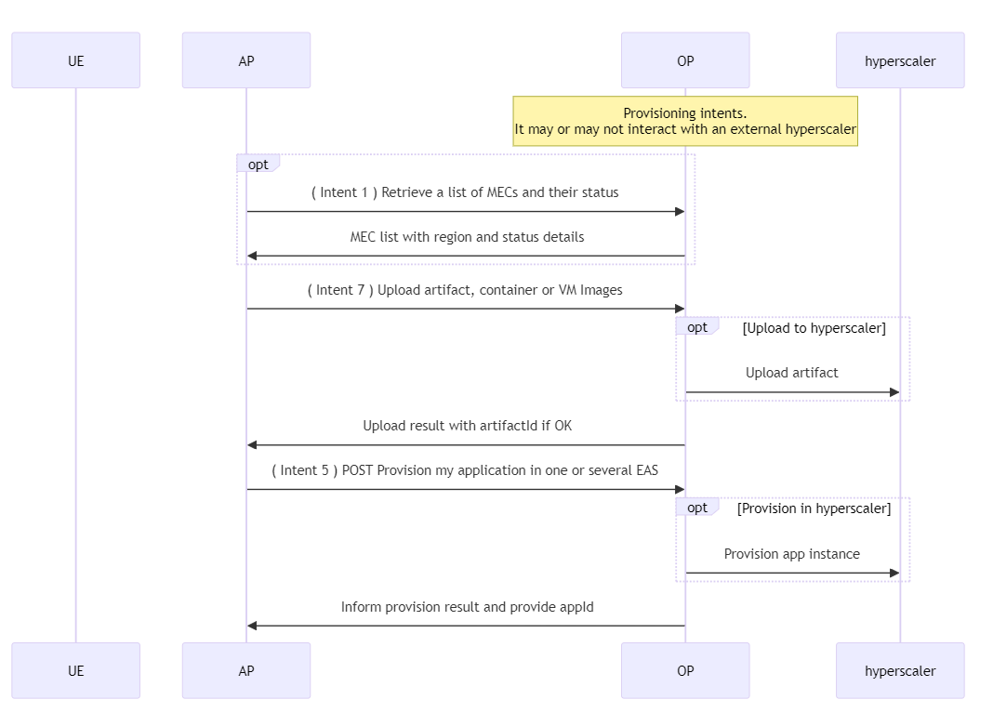
Intents Flow Graphs – MEC provisioning
camara Edge cloud status

Slide 9
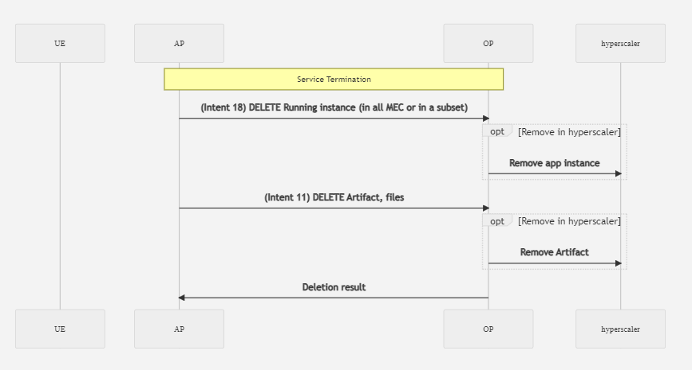
Intents Flow Graphs – Service Termination
camara Edge cloud status

Slide 10
Backup

Slide 11
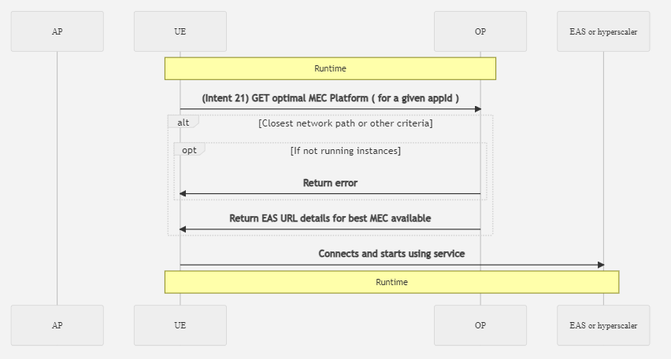
Intents Flow Graphs – MEC RUNTIME
camara Edge cloud status

Slide 12
Intents analysis: Intent 1.
CAMARA EDGE CLOUD STATUS
Developer intents: Provisioning intents | 5SED | 5MEE | EXRA | EXRC | EXCA | EXSM | GMEC
1. “I can retrieve a list of the operator’s MECs and their status, ordering the results by location and filtering by status (active/inactive/unknown)” | No | Yes | Yes | N/A | N/A | N/A | N/A
5MEE | Details | Comments
GET /mecplatforms | Returns a list of optimal MEC Platforms where you can register your deployed application. You can choose to search without passing any of the inputs paramaters or a combination of Service Profile, Region, subscriber density or UEIdentity. | Is the response ordered by location? How can be done the filter by (active/inactive/unknown)? Is there any other call to be used?
EXRA | Details | Comments
POST /api/v1/auth/ctrl/ShowCloudlet | Show Cloudlets. Lists all the cloudlets managed from Edge Controller. | Is the response ordered by location? How can be done the filter by (active/inactive/unknown)? Is there any other call to be used?

Slide 13
Intents analysis: Intent 5.
CAMARA EDGE CLOUD STATUS
Developer intents: Provisioning intents | 5SED | 5MEE | EXRA | EXRC | EXCA | EXSM | GMEC
5. "I can ask the operator to provision my application server to the optimal MEC for a specific terminal, taking into account connectivity, resources (e.g. vCPU, Memory, network interfaces, storage, GPU) shortest network path, cost, network load, MEC platform load, application privacy considerations etc." | No | Yes | Yes | N/A | N/A | N/A | Yes
5MEE | Details | Comments
GET /mecplatforms\?UEIdentityType=[a-zA-Z0-9-]*\&UEIdentity=[a-zA-Z0-9.-]*? | Return the optimal MEC platform for a given UE identifier | Method may use this input parameters: region,zone,serviceProfileId,subscriberDensity, UEIdentityType,UEIdentity This method does not cover provision, which API method can be invoked to trigger provision?
EXRA | Details | Comments
POST /api/v1/auth/ctrl/CreateApp | Create Application. Creates a definition for an application for Cloudlet deployment. It supports autoprovision policies triggered in combination with findcloudlet | It requires also autoprovision policy to trigger auto app instance.
POST /api/v1/auth/ctrl/CreateAppInst | Create Application Instance. Creates an instance of an App on a Cloudlet where it is defined by an App plus a ClusterInst key. Many of the fields here are inherited from the App definition | API user needs to specify the cloudlet manually where to instantiate the app, it may use external data to make that decision.
POST /v1/findcloudlet | Find the best application service running on a cloudlet in the Edge Cloud for the client to use, based on proximity and other policies. It may trigger autoprovision of app instance in case autoprovision policy is in place | Method invoked from UE nomally: Input parameters: gps_location, additionalProp1-3 Prerequsite autoprovision policy configured By default it uses geo proximity and no other considerations.
GMEC | Details | Comments
GET /application/lcm/{appId} | Instantiates an application on an OP zone. Details about application and zones where application instance should be created. Field 'operator' and 'opCountry' should be specified if the zone belongs to a partner OP. | This is the method to instantiate the app. Which method is used to identify the optimal MEC? Does it take into account all intent options?

Slide 14
Intents analysis: Intent 7.
CAMARA EDGE CLOUD STATUS
Developer intents: Provisioning intents | 5SED | 5MEE | EXRA | EXRC | EXCA | EXSM | GMEC
7. “I can ask the operator to store artifacts e.g., container images or VM images and manifests describing required resources, Helm charts etc” | N/A | N/A | N/A | N/A | N/A | N/A | Yes
GMEC | Details | Comments
POST /artifact | Uploads application artifact on an OP. Artifact is a zip file containing scripts and/or packaging files like Terraform or Helm which are required to create an instance of an application. | An application can consist of multiple components. App providers are allowed to define seperate artifacts for each component or they could define a consolidated artifact at application level. Returns ArtifactId
POST /files | Uploads an image file. Application provider uses this api to onboard an application image to an OP. | Includes parameters: fileType : Indicate if the file is Container image or VM image (QCOW2) imgOSType : Base OS for the image. Currently only “Linux” is supported Returns fileId

Slide 15
Intents analysis: Intent 21. (Very similar to intent 20)
CAMARA EDGE CLOUD STATUS
Developer intents: Runtime intents | 5SED | 5MEE | EXRA | EXRC | EXCA | EXSM | GMEC
21. "I can discover the optimal application service endpoint for a specific terminal, taking into account mobility events, connectivity, shortest network path, cost, network load, MEC platform load etc." | No | Yes | N/A | Yes | N/A | N/A | N/A
5MEE | Details | Comments
GET /mecplatforms\?UEIdentityType=[a-zA-Z0-9-]*\&UEIdentity=[a-zA-Z0-9.-]*? | Return the optimal MEC platform for a given UE identifier | Method may use this input parameters: region,zone,serviceProfileId,subscriberDensity, UEIdentityType,UEIdentity1 Any considerations for mobility events?
EXRA | Details | Comments
POST /v1/findcloudlet | Find the best application service running on a cloudlet in the Edge Cloud for the client to use, based on proximity and other policies. It may trigger autoprovision of app instance in case autoprovision policy is in place, by default only detects optimal MEC where the app was already instantiated | Method invoked from UE nomally: Input parameters: gps_location, additionalProp1-3 Prerequsite autoprovision policy configured By default it uses geo proximity and no other considerations.
POST /v1/getappinstlist | Like FindCloudlet, but returns a short list of the best instances instead of a single result, allowing the client to choose based on its own criteria, or maintain several parallel connections to different sites. | Input parameters: gps_location, additionalProp1-3 It does not detect shortest network path directly it may be used to measure latency from UE to available MECs Any considerations for mobility events?

Slide 16
Intents analysis: Intent 18.
CAMARA EDGE CLOUD STATUS
Developer intents: Provisioning intents | 5SED | 5MEE | EXRA | EXRC | EXCA | EXSM | GMEC
18. "I can ask the operator to terminate the running instance of my application" | N/A | N/A | N/A | N/A | N/A | N/A | Yes
GMEC | Details | Comments
DELETE /application/lcm/{appId}/instance/{appInstanceId}/zone/{zoneId} | Terminate an application instance on a partner OP zone. | Required parameters: Appid, appinstanceId and zoneId

Slide 17
Intents analysis: Intent 11.
CAMARA EDGE CLOUD STATUS
Developer intents: Provisioning intents | 5SED | 5MEE | EXRA | EXRC | EXCA | EXSM | GMEC
11. "I can ask the operator to delete an existing artifact(s)" | N/A | N/A | N/A | N/A | N/A | N/A | Yes
GMEC | Details | Comments
DELETE /artifact/{artifactId} | Removes an artifact from an OP. | It may respond with conflict errors

